Slide 1
Loops
By
Rabbia Mahum

Slide 2
Why Loops?
Loops cause a section of your program to be repeated a certain number of times.
Repeats until the condition remains true.
Terminates when the condition becomes false.

Slide 3
Loops in C++
For loop
While loop
Do-While loop

Slide 4
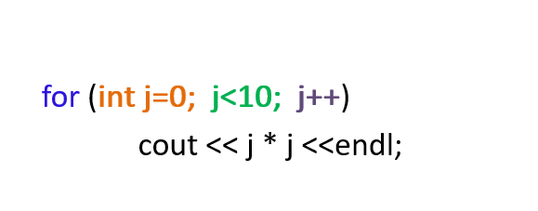
Syntax of for loop

Slide 5
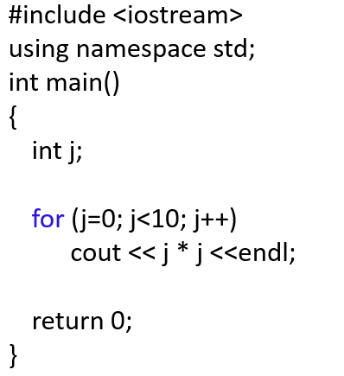
Example

Slide 6
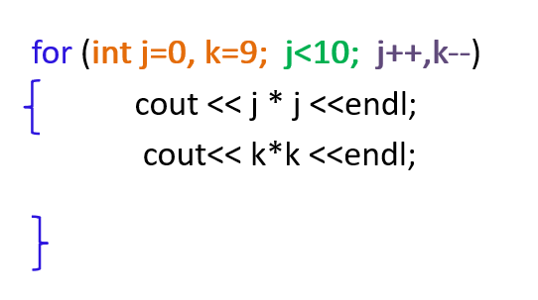
For loop-multiple expressions

Slide 7
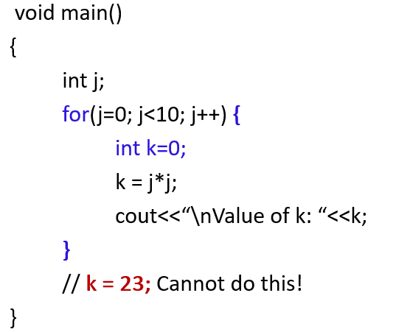
Variable visibility

Slide 8
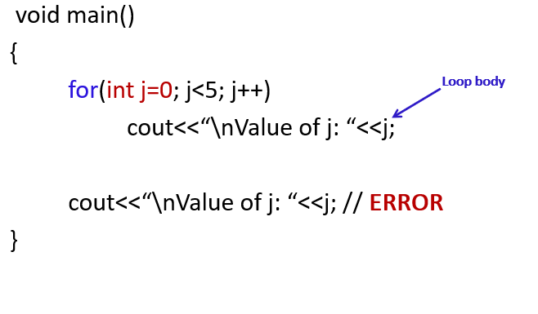
Variable visibility

Slide 9

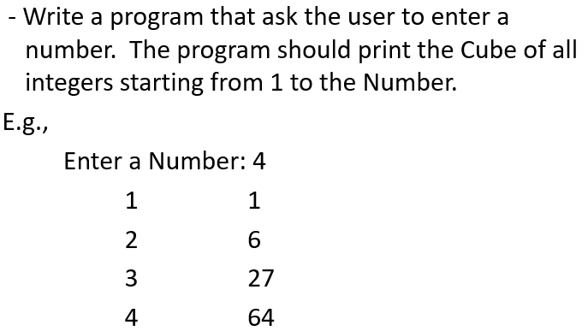
Programs

Slide 10
While Loop
◼The while loop continues to loop while some condition is true.
◼When the condition becomes false, the looping is discontinued.
◼The general from of while loop is,initialize loop counter ;
while(test loop counter using a condition)
{
do this;
and this;
increment loop counter ;
}

Slide 11
Important Points
In place of the condition there can be any other valid expression.
◼So long as the expression evaluates to a non-zero value the statements within the loop would get executed.
◼The condition being tested may use relational or logical operators as shown in the following examples.
While(i<=10)
While(i>=10 && j<=15)
While (j>10 && (b<15 || c<20))

Slide 12
Indefinite loop
◼As a rule the while must test a condition that will eventually become false, otherwise the loop would be executed forever, indefinitely.
◼Instead of incrementing, we can decrement the counter as well.
◼It is not necessary that a loop counter must only be an int. it can be even float.

Slide 13
Problem
◼Write a program that find the sum of all the digits from 1 to given number??? ◼ Write a program that find the even upto a given number and add all the those even numbers?

Slide 14
Break Statement
The break statement can be used to jump out of a loop.
This example jumps out of the loop when i is equal to 4:
Example:
for (int i = 0; i < 10; i++) { if (i == 4) { break; } cout << i << "\n"; }
Output:
0
1
2
3

Slide 15
Continue Statement
The continue statement breaks one iteration (in the loop), if a specified condition occurs, and continues with the next iteration in the loop.
This example skips the value of 4:
Example:
for (int i = 0; i < 10; i++) { if (i == 4) { continue; } cout << i << "\n"; }
Output:
0
1
2…..9

Slide 16
The Do/While loop
The do/while loop is a variant of the while loop. This loop will execute the code block once, before checking if the condition is true, then it will repeat the loop as long as the condition is true.
Syntax:
do { // code block to be executed } while (condition);

Slide 17
The Do/While loop
The example below uses a do/while loop. The loop will always be executed at least once, even if the condition is false, because the code block is executed before the condition is tested:
For Example:
int i = 0; do { cout << i << "\n"; i++; } while (i < 5);

Slide 18
Problem of Do-While loop
Write a program that find the even upto a given number and add all the those even numbers?

Slide 19


